Slide 1
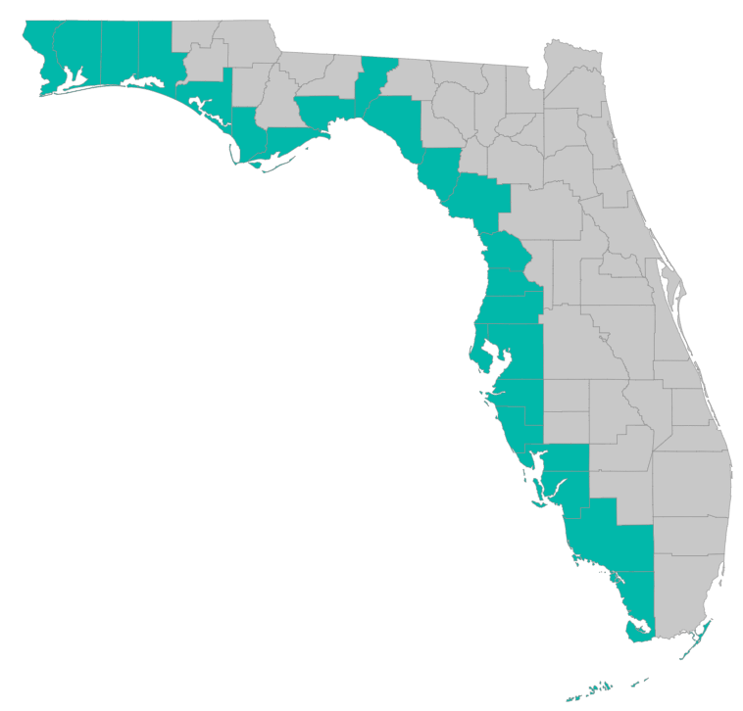
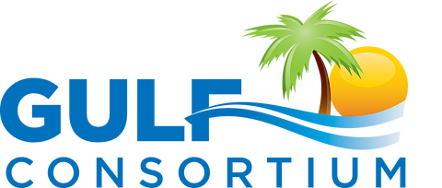
Observational Data Plans (ODP) and Data Management Plans (DMP) – what they are and how to prepare them

Slide 2
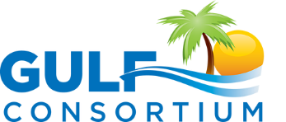
Application Preparation – guidance
What is needed to submit a subaward application?
See guidance document at
https://www.gulfconsortium.org/grant-resources
Abstract/Executive Summary
Project Narrative (BAS)
Budget Narrative
Milestone information
Metrics information (BAS)
Project Map
GIS shapefiles
Data Management Plan (BAS)
Observational Data Plan (BAS)

Slide 3
Application Preparation – guidance
The RESTORE Act defines “best available science” as science that:
Maximizes the quality, objectivity, and integrity of information, including statistical information;
Uses peer-reviewed science or publicly available data; and
Clearly documents and communicates risks and uncertainties in the scientific basis for such projects.

Slide 4
ODP and DMP
What are they?
Observation Data Plan – describes data collection and compilation
Data Management Plan – describes data storage, security, delivery
What are they for? – according to Council
Assist in Council reporting
Ensure projects are compliant with financial award
Determine whether projects are meeting intended objectives and outcomes
Allows for future adaptive management actions – if needed

Slide 5
ODP and DMP
ODP – metrics and measures
Metrics – big-picture, “umbrella”, used to quantifiably determine project success: should (if possible) come from Council list (see “Metrics Choices Table” - https://www.gulfconsortium.org/grant-resources)
Measures – the data behind the metric; example:
Metric: Wetland Restoration – Number of Acres Restored
Metric Success Criteria: 100 Acres Restored
  Measure I. Habitat Composition--Golden Island contains unique categories of terrestrial and aquatic habitats including beach and dune, intertidal flats, wetlands, and upland/scrub shrub.
  Success Criteria: Maintain habitat diversity of emergent and submerged habitats over time including beach and dune, intertidal flats, wetlands, and upland/scrub shrub.

Slide 6
ODP and DMP
What’s needed at grant application stage?
ODP and DMP needed for every application
For grant applications for design or planning work: the ODP and DMP has be tracking the outputs associated with those milestones
They will evolve with each application: for example – ODP for preliminary design will have metrics to document design work and maybe minimal detail on actual on-the-ground monitoring (water quality, acres preserved, etc), but successive applications for grants within a project will advance the ODP to be more complete and detailed

Slide 7
ODP and DMP
Other questions
Do we need to show site control or easements for monitoring access?
No, Council assumes that site control will be established by the Consortium or its subrecipients – evidence of site control at the time of grant applications is optional
How do we need to document monitoring locations – are maps needed?
Maps are helpful, but not required. Narrative descriptions of locations will suffice.

Slide 8
Other general questions
Is Florida State Clearinghouse (SCH) review needed?
No, the “Notice of Funding Availability: Spill Impact Component Project Grants” indicates that…
“6. Intergovernmental Review
Applications under this announcement are not subject to Executive Order 12372, Intergovernmental Review of Federal Programs.”
https://restorethegulf.gov/sites/default/files/NOFA_SEPs_Final_Draft_ver20160524.pdf

Slide 9
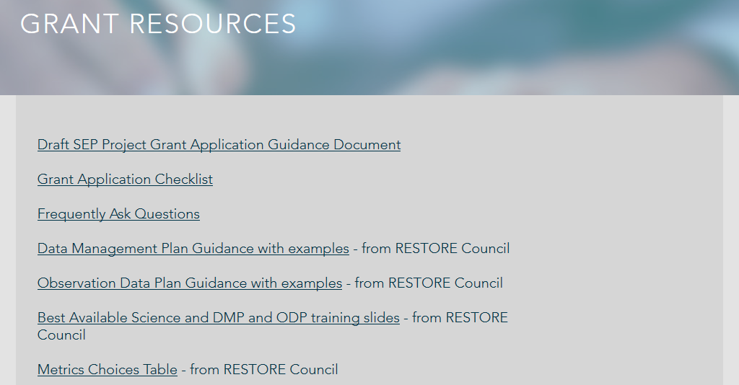
Application Preparation – guidance
Guidance documents
https://www.gulfconsortium.org/grant-resources

Slide 10
Application Preparation – guidance
How to submit a subaward application?
Online submittal form with attachments:
https://www.gulfconsortium.org/grant-resources
Attach all required documents as Word documents or pdf map and zipped shapefiles (for project location)

Slide 11
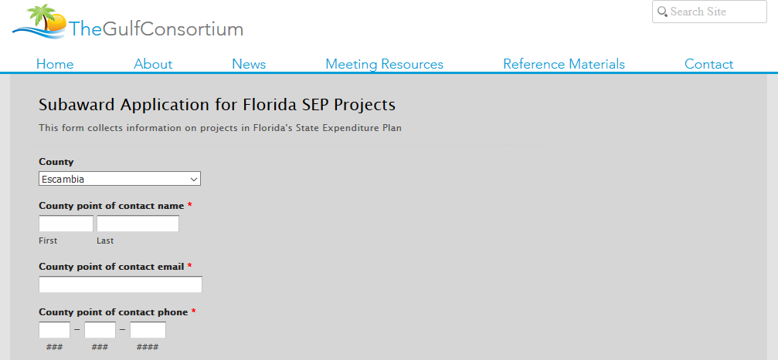
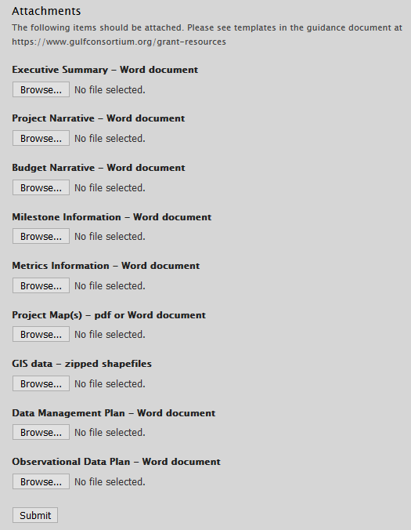
Application Preparation – guidance
How to submit a subaward application?

Slide 12
Application Preparation – guidance
Questions…
Contact:
Daniel Dourte
407.629.2185 ext. 113
ddourte@balmoralgroup.us

Slide 13
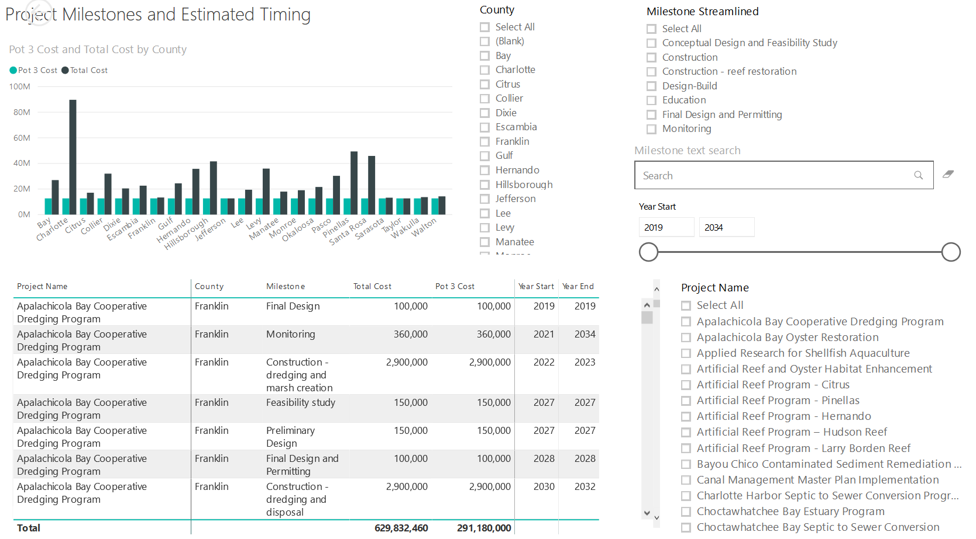
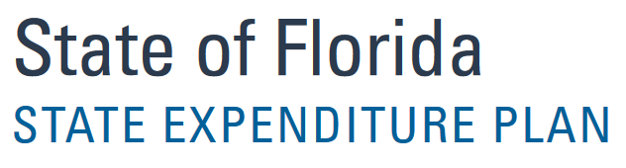
Application Preparation – Implementation Milestones and timing
Dashboard for Project Data
http://datavisual.balmoralgroup.us/GulfConsortiumProjects
milestones, start years, cost, goals, funding sources
GOAL:
Efficient, accurate grant application preparation
Interface for project details
Better, faster decisions on grant timing, readiness, bundling
Transparent tracking of progress and changes

